Slide 1
CAPSTONE PROJECT-2
Big Mart Sales Data

Slide 2

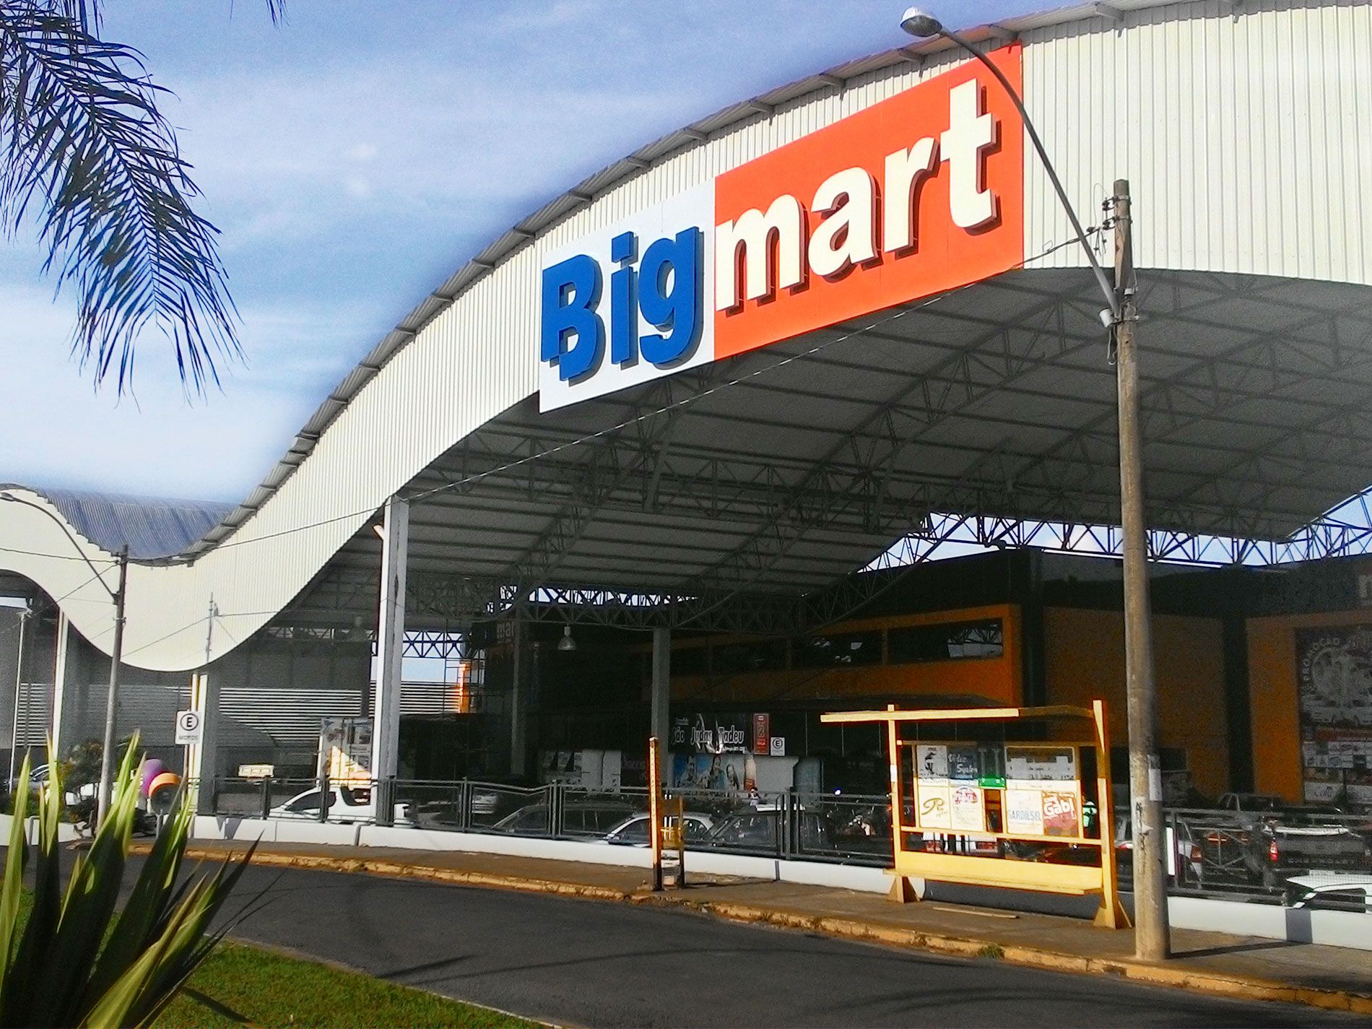
Welcome To BIGMART

Slide 3

TEAM MEMBERS:-
2210992355 (Shruti Bansal)
2210992401 (Soumya Makkar)
2210992428 (Vinay Kumar Mangal)
2210992432 (Vinit Kumar)

Slide 4

CONTENT:-
Problem Statement
Objective
Tools Used
Data Summary
Exploratory
Challenges
Models Used
Recommendations
Conclusion

Slide 5

Problem Statement:-
BigMart, a leading retail company, faces challenges in accurately forecasting sales for its diverse range of products across multiple outlets. Inconsistent and unreliable sales predictions can lead to inefficient inventory management, resulting in either overstock or stockouts, which in turn affects profitability and customer satisfaction.
The project aims to develop a machine learning model that can accurately predict sales for each item-outlet combination based on historical sales data and other influencing factors such as item characteristics, pricing, outlet location, and other features. The model should be capable of providing actionable insights that can inform strategic decisions related to inventory planning, pricing, and promotions.

Slide 6

OBJECTIVE:-
The objective of this project is to predict sales for BigMart using AI/ML models to provide actionable insights and aid decision-making in sales and inventory management. The dataset consists of columns such as Item_Identifier, Item_Weight, Item_Fat_Content, Item_Visibility, Item_Type, Item_MRP, Outlet_Identifier, Outlet_Establishment_Year, Outlet_Size,Outlet_Location_Type, Outlet_Type, and Item_Outlet_Sales. By focusing on sales prediction, the project offers BigMart a powerful tool to optimize operations, improve customer satisfaction, and increase revenue. The models and insights provided can support the company's decision-making process in various areas, including inventory management, marketing, and strategic planning.

Slide 7

Tools used:-
Google collab is used as IDE(Integrated Development Environment).
Pandas and NumPy are used for Data Manipulation & Pre-processing and Mathematical functions respectively.
Exploratory data analysis is automated by data preparation.
For visualization of the plots, Matplotlib, Seaborn, Plotly are used.
Scikit is used for model making.

Slide 8

DATA SUMMARY:-
Categorical columns
Item_Identifier
Item_Fat_Content
Numerical columns
Item_weight
Unique columns
Item_Identifier
Item_type
Outlet_Identifier
Outlet_Location_Type
Outlet_Type
Item_Visibility
Item_MRP
Outlet_Establishment_Year
Item_Outlet_Sales

Slide 9

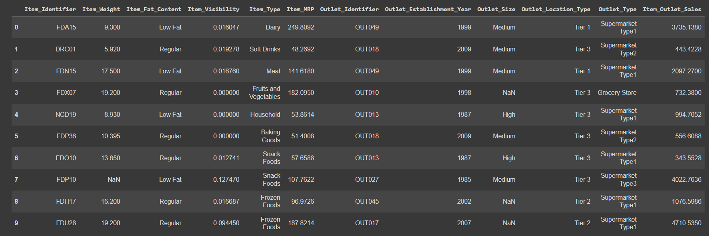
Data SUMMARY:-
This is the dataset of BigMart. Below are the first 10 rows of the dataset.

Slide 10

FEATURES DESCRIPTION:-
Item_Identifier :- A unique identifier for each item. It helps distinguish between different products which can have different sales pattern.
Item_Weight :- The weight of each item. Heavier items may incur higher storage cost, affecting prices and, in turn, sales.
Item_Fat_Content :- Indicates whether an item is low fat or regular fat. This can affect the customer preference and sales for specific items.
Item_Visibility :- Measures the visibility of an item in the outlet. Higher visibility may lead to higher sales due to increased customer satisfaction.

Slide 11

shruti
Item_Type :- Describes the category of food item. Different food items may have different sales trends and customer demand.
Item_MRP :- The maximum price at which an item can be sold. Pricing has a direct impact on sales. Lower prices may increase demands.
Outlet_Identifier :- A unique identifier for each outlet. Different outlets may have different customer bases and sales demand.
Outlet_Establishment_Year :- The year the outlet was established. Older outlets may have a more established customer base and sales trends.
Outlet_Size :- Describes the size of outlet(eg low , medium, high). Larger outlets may have higher sales due to more inventory and customer traffic.

Slide 12

shruti
Outlet_Location_Type :- Describes the type of location(eg Tier 1, Tier 2 ,etc). Location type may impact the customer base and sales trend.
Outlet_type :- Describes the type of outlet(eg supermarket, grocery store, etc . Different outlet types may attract different types of customers and influences sales.
Item_Outlet_Sales :- The target variable representing the sales of a specific item at a specific outlet. The goal of the project is to predict this variable.

Slide 13
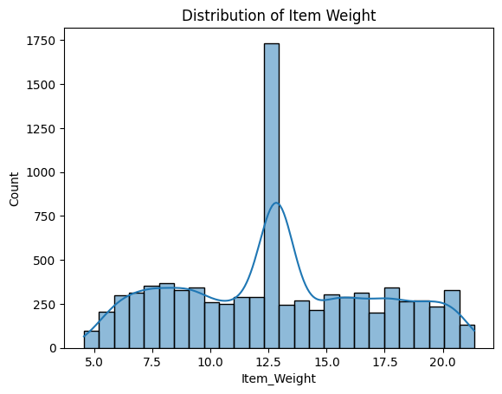
Analyzing the distribution of item weights:-
We can say that maximum orders were placed of the items which weighed near about 12.5 units.

Slide 14
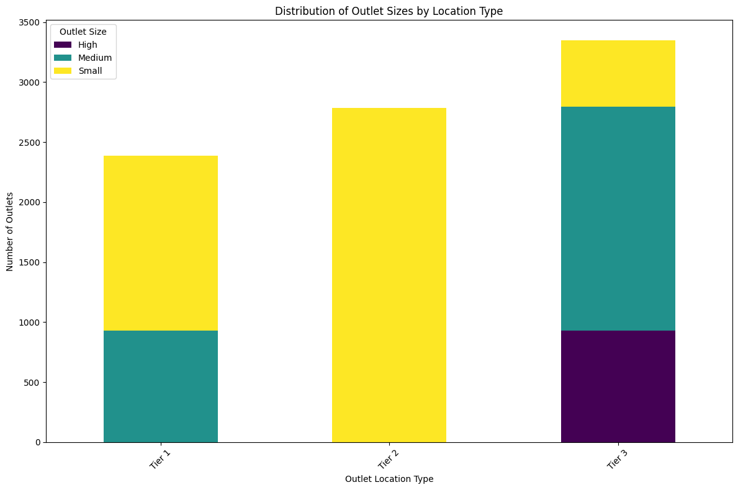
ANALYZING DISTRIBUTION OF OUTLET SIZES BY LOCATION TYPE:-
We can say that Tier 1 does not have big outlets, tier 2 only has small outlets and tier 3 has outlets of all sizes.

Slide 15
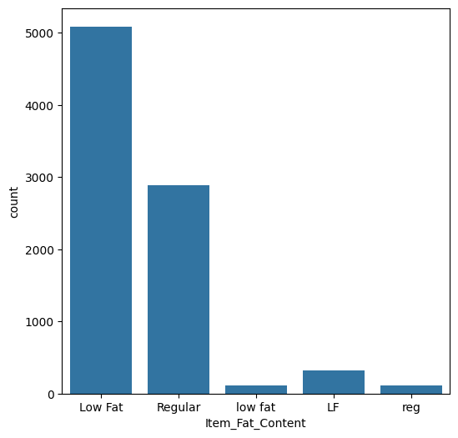
Which FAT CONTENT ITEM IS MOST ORDERED:-
We can say that customers mainly prefer items with low fat.

Slide 16
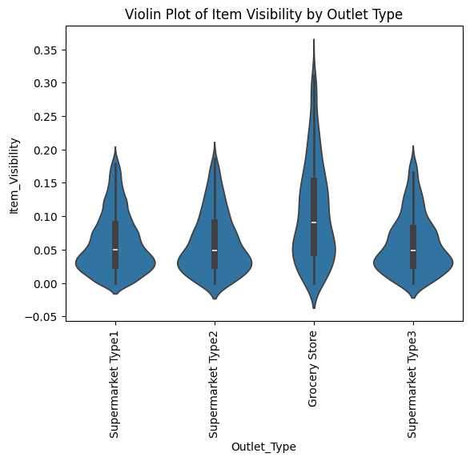
ANALYZING ITEM VISIBILITY BY OUTLET TYPE:-
We can say that supermarkets have higher visibility than grocery stores.

Slide 17
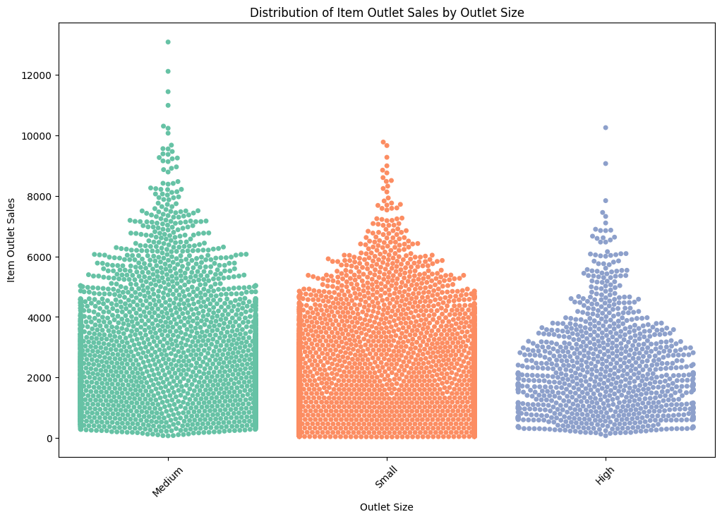
Distribution of Item Outlet Sales by Outlet Size:-
From the graph below, we can say that people prefer to buy food items from medium and small outlets.

Slide 18
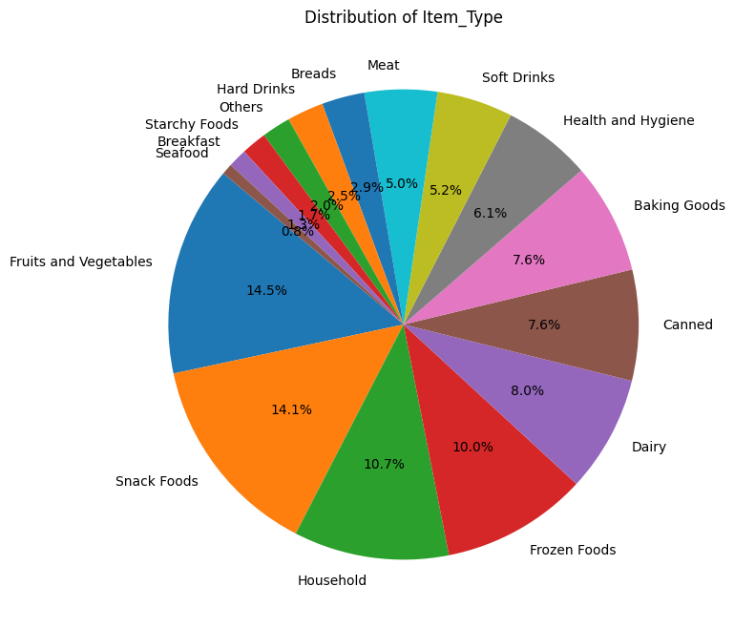
ANALYZING NUMBER OF ORDERS OF EACH TYPE OF FOOD ITEM:-
We can say that fruits, vegetables and snack foods are most ordered.

Slide 19
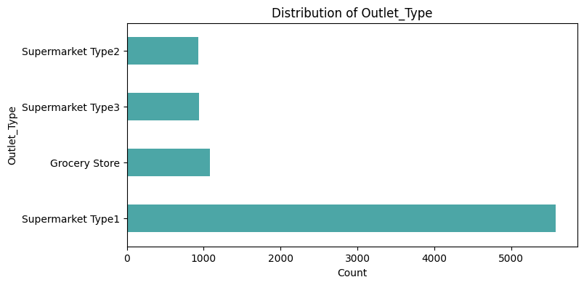
ANALYZING SALES OF DIFFERENT TYPES OF OUTLETS:-
We can say that Supermarket Type-1 has maximum sales.

Slide 20
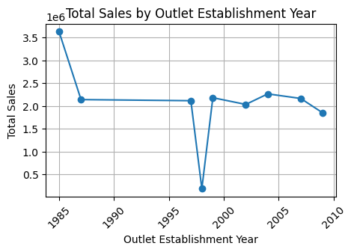
Analyzing Total sales by outlet establishment year:-
We can say that maximum orders are placed from the oldest outlet.

Slide 21
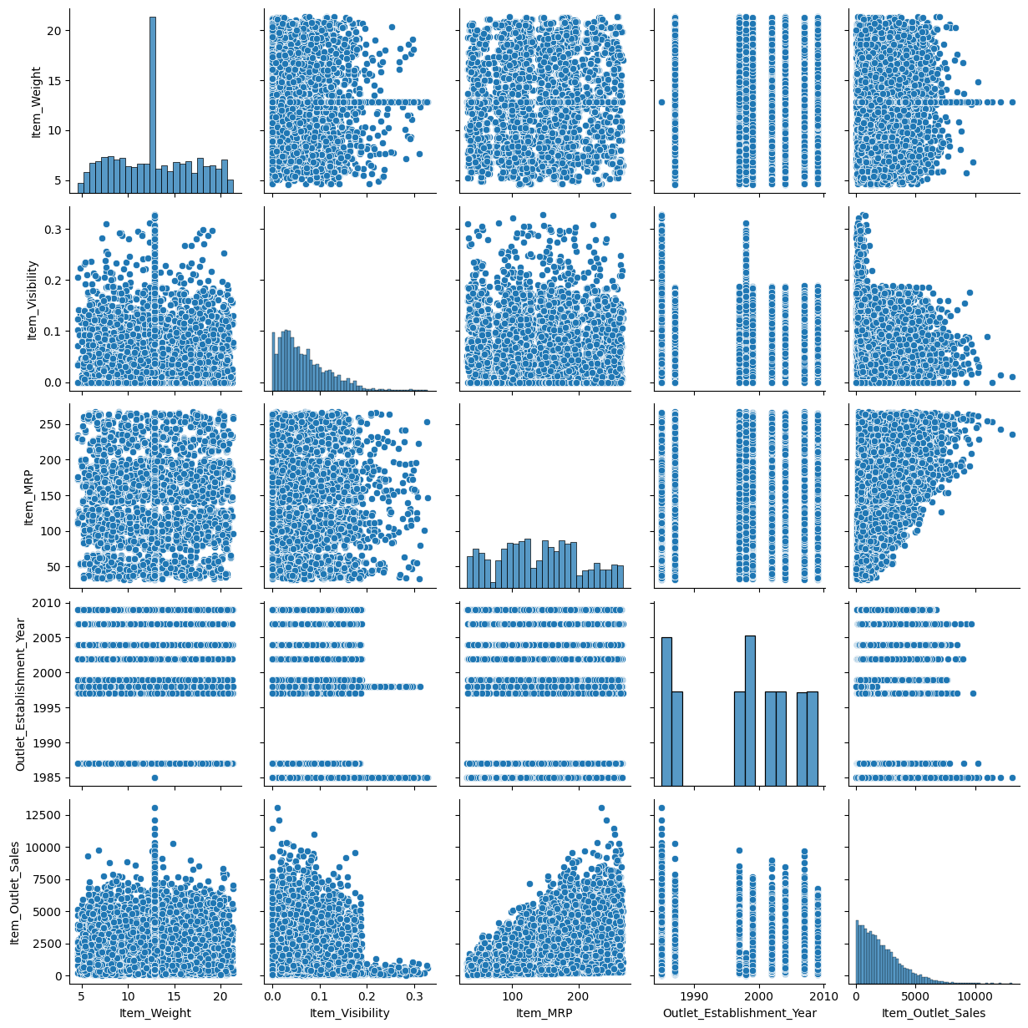
PAIR PLOT :-

Slide 22

CHALLENGES:-
There were many missing values.
Data needed encoding.
Huge number of outliers.
Had to remove some irrelevant features which were not playing any role in determining the sales.

Slide 23
MODELS USED:-
Models used
Linear regression
Linear regression is used to model the relationship between variables, predict outcomes, and understand correlations.
Prediction:-
R2 score 0.48624380425175895
Root Mean Squared Error 1259.3664118274296
Support Vector Regression
Support Vector Regression (SVR) is utilized for non-linear regression tasks by mapping data points into a higher-dimensional space, aiming to find the optimal hyperplane that best fits the data, useful in predicting continuous outcomes and handling complex relationships between variables in fields like finance and engineering.
Prediction:-
R-squared score: 0.4410506443960891
Decision tree
Decision trees are employed for classification and regression tasks, creating a tree-like model where each internal node represents a test on an attribute, guiding decisions to predict outcomes, widely applied in fields like healthcare and marketing for its interpretability and ability to handle non-linear relationships in data.
Prediction:-
R-squared score: 0.4410506443960891

Slide 24

RECOMMENDATIONS:-
Explore Market Expansion Opportunities: Identify regions or location types with consistent positive sales growth trends and consider expanding operations in those areas. Conduct market research to understand consumer preferences and tailor product offerings to local demand.
Optimize Inventory Management: Utilize sales trend data to forecast demand more accurately and optimize inventory levels. Implement inventory management systems to reduce stockouts and minimize carrying costs while ensuring product availability to meet customer demand.
Enhance Marketing Strategies: Develop targeted marketing campaigns based on historical sales data to reach specific customer segments effectively. Utilize digital marketing channels and data analytics tools to personalize marketing messages and drive customer engagement.
Improve Outlet Performance: Conduct performance evaluations of individual outlets based on sales trends and identify opportunities for improvement. Provide training and support to outlet managers to enhance customer service, optimize product placement, and implement effective promotional strategies.
Diversify Product Offerings: Analyze sales data to identify underperforming product categories and explore opportunities to diversify product offerings. Introduce new products or variations to meet evolving consumer preferences and expand market reach.

Slide 25

CONCLUSION:-
In conclusion, this project delved into the analysis of Big Mart sales data using AI and machine learning techniques. Through comprehensive exploration, significant insights were unearthed regarding consumer behavior, product performance, and sales trends. The models developed showcased commendable performance, providing valuable predictive capabilities for future sales forecasting and decision-making.
The findings of this project hold substantial implications for Big Mart's operational strategies, offering opportunities for optimizing inventory management, pricing strategies, and marketing initiatives. By leveraging data-driven insights, the company can enhance its competitiveness and better meet the evolving needs of its customers.
Overall, this project underscores the transformative potential of AI and machine learning in driving business success and fostering innovation in the realm of retail. Through continued exploration and application of these technologies, Big Mart and similar enterprises can navigate the complexities of the market landscape with confidence and agility.

Slide 26


